Slide 1


Feature Extraction and Price Prediction for Mobile Phones
By Latha Payani

Slide 2
Project Description and Objectives
1. Data Exploration
Analyzed mobile phone dataset to identify feature relevance effectively
5. Model Evaluation
Used Random Forest to assess predictive accuracy of the model developed
7. Recommendations
Suggest pricing strategies based on feature analysis and market insights
6. Feature Importance Analysis
visualizations to illustrate feature
importance and insights
2. Preprocessing Steps
Addressed missing values and preprocess data for accurate predictions
3. Feature Extraction
Creating new features based on existing data to enhance model performance
4. Model Building
Chosen suitable algorithms like regression, decision trees ,etc for prediction. Data Splitting for prediction

Slide 3
Data Pre-processing
Handling Missing Values and Outliers
Imputation Deletion
Used mean or median for numeric features with Removed rows with excessive missing data to Missing Values ensure quality.
Duplicate Values Data Validation
By Using dropna() , I have removed duplicates in data Implement checks to ensure data meets quality
Standards before analysis.
Outlier Detection Consistency Check
Implemented IQR methods to find outliers. Capped outliers Ensured imputed values are consistent with
to reduce their on model training., used box plots to visualize feature distributions.
outliers before treatment.

Slide 4
Encoding Categorical Variables
One-Hot Encoding
Applied to categorical variables to create binary columns, allowing the model to treat these categories independently.
Label Encoding
Used for ordinal variables where categories have a meaningful order, converting them to numerical values accordingly
Avoiding Dummy Variable Trap
Carefully manage one-hot encoding to prevent redundancy, which can lead to issues in linear models' interpretations

Slide 5
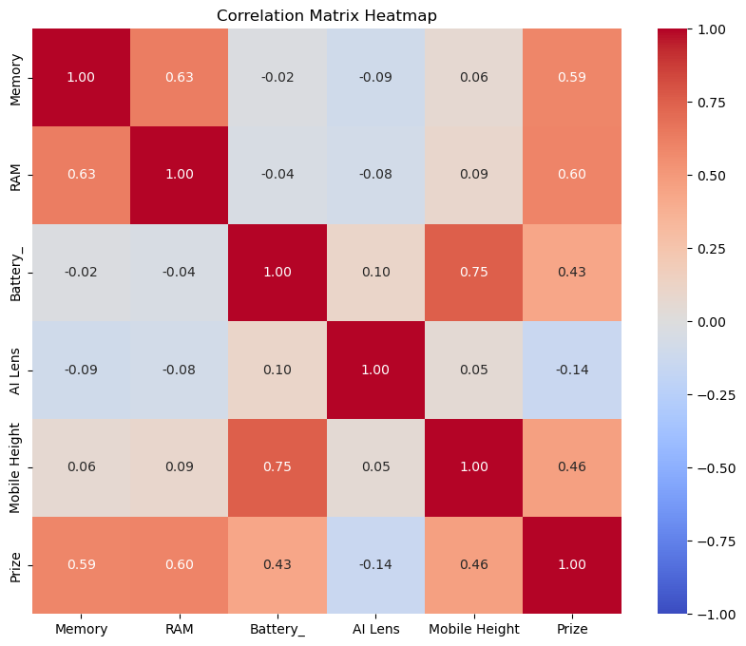
Feature Extraction Methods
Correlation Utilized correlation coefficients to identify the strength and direction of relationships between features and mobile phone prices, guiding focus on most impactful features for prediction.
Regression
Applied regression analysis to quantify the contribution of each feature in predicting prices, allowing for insights into key determinants influencing mobile phone pricing strategies.

Slide 6
Visualization Techniques for Feature Analysis
Heat map
Utilized heat maps to illustrate correlations between features key influencers and price to identify
1
Bar Graphs
Bar graphs for visualizing the feature importance derived from the predictive models for better insights.
2
Scatter Plots
Created scatter plots to analyze relationships between specific features and mobile phone prices effectively.
3
HistPlot
visualize the distribution of a dataset. It displays the frequency or count of data points within certain ranges or bins, showing the shape of the data distribution.
4
PairPlot
visualize the relationships between multiple variables in a dataset. It's especially useful when working with datasets that have more than two variables, allowing you to quickly explore the interactions between all pairs of variables.
5

Slide 7
Model Building: Training and Testing Sets
1
2
3
4
5
6
Initial Review
Data Split
Training Set
Testing Set
Model Training
Evaluate Model
Conducted an initial review to understand data structure
Divide the dataset into training and testing subsets
Utilize the training set to build predictive models
Reserve the testing set for evaluating model performance
Train the model using selected algorithms on the training data
Evaluate the model's performance using the testing data

Slide 8
Selection of Machine Learning Algorithms
Linear Regression Decision Trees
Simple and interpretable, ideal for price estimation Intuitive and easy to visualize, handles
tasks non-linear relationships
Random Forests Gradient Boosting
Robust model, reduces overfitting through ensemble High accuracy, works well with complex learning techniques datasets and feature interactions
KneighborsRegressor
The model predicts the target value (e.g., price) of a data point by averaging
the target values of its k-nearest neighbors in the feature space

Slide 9
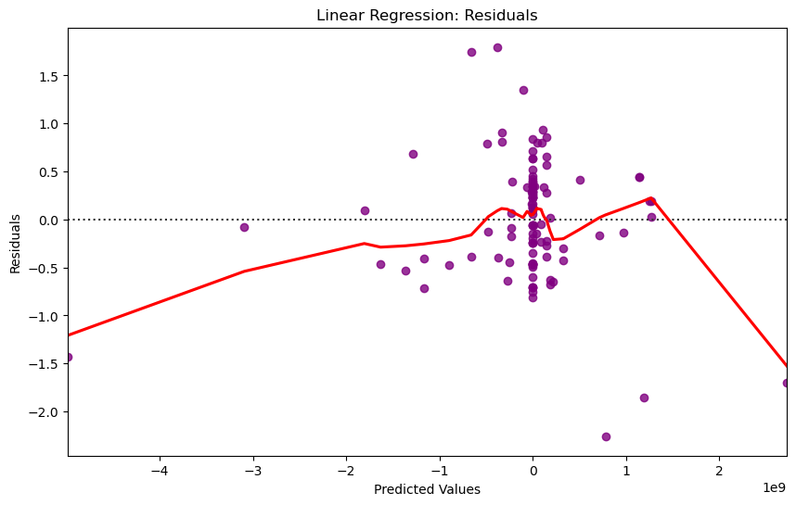
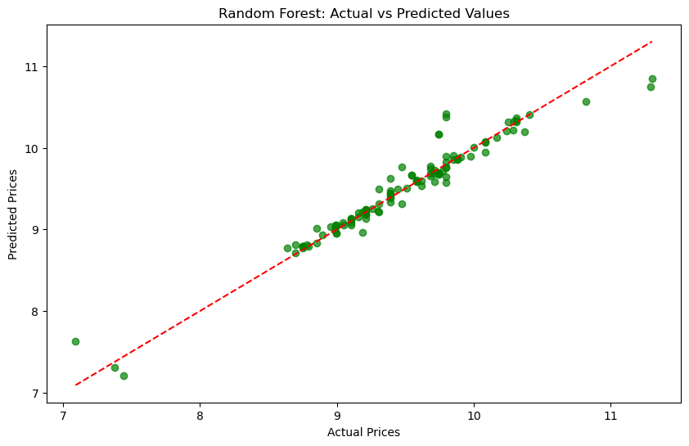
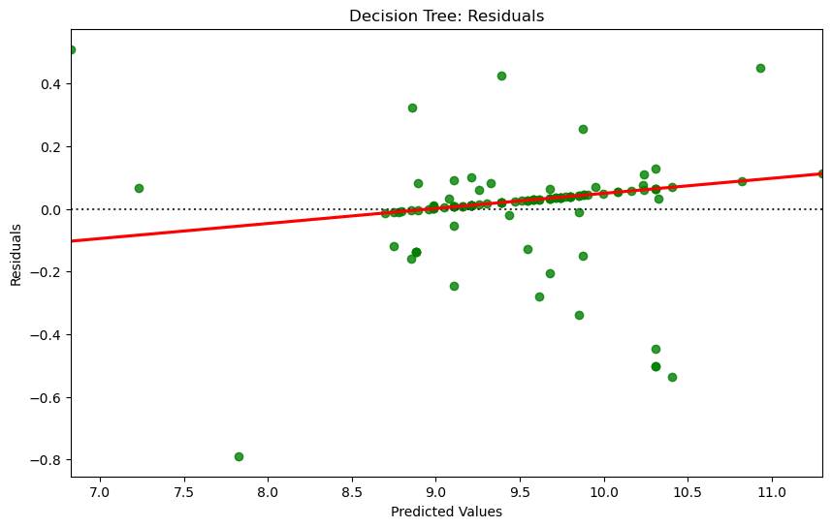
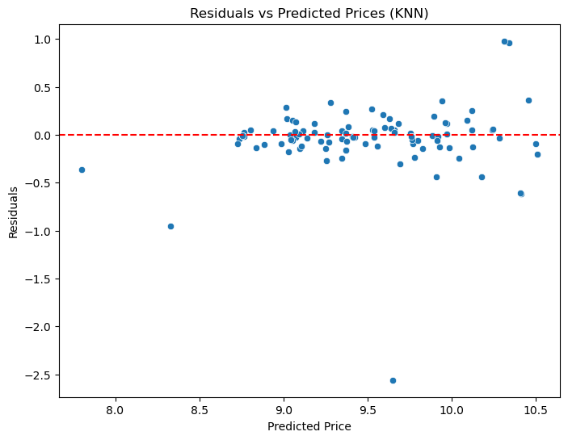

Slide 10
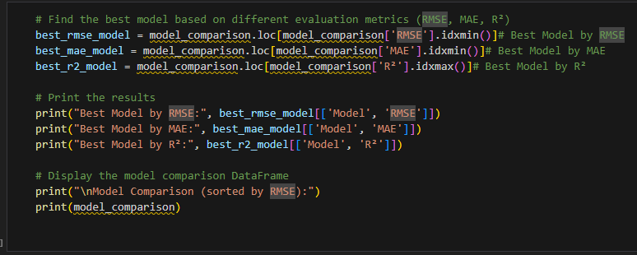
Model Evaluation Metrics
Mean Absolute Error:
Calculate the absolute differences between predicted and actual prices, then average these values
Root Mean Squared Error:
Measure the square root of the average of squared differences between predicted and actual prices
Model Comparison
Used MAE and RMSE to compare different models, helping to identify the most accurate price predictor

Slide 11
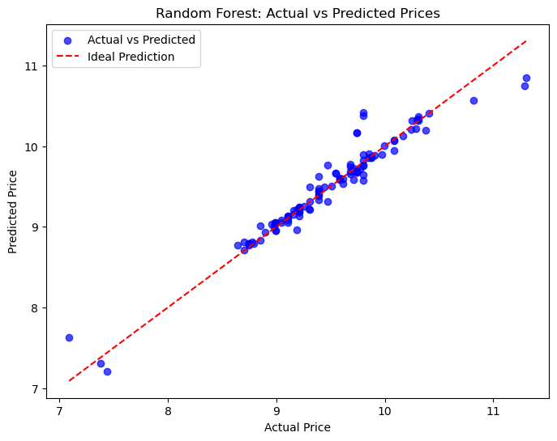

Slide 12
Feature Importance Analysis from Models
Camera Specs
High-quality rear cameras significantly boost mobile phone prices
Memory Size
Larger RAM and storage are critical for determining product value
Battery Capacity
Longer battery life correlates with higher consumer willingness to pay
Processor Power
Faster processors are linked to significantly higher market prices
AI Features
Integration of AI capabilities enhances pricing potential of devices.

Slide 13
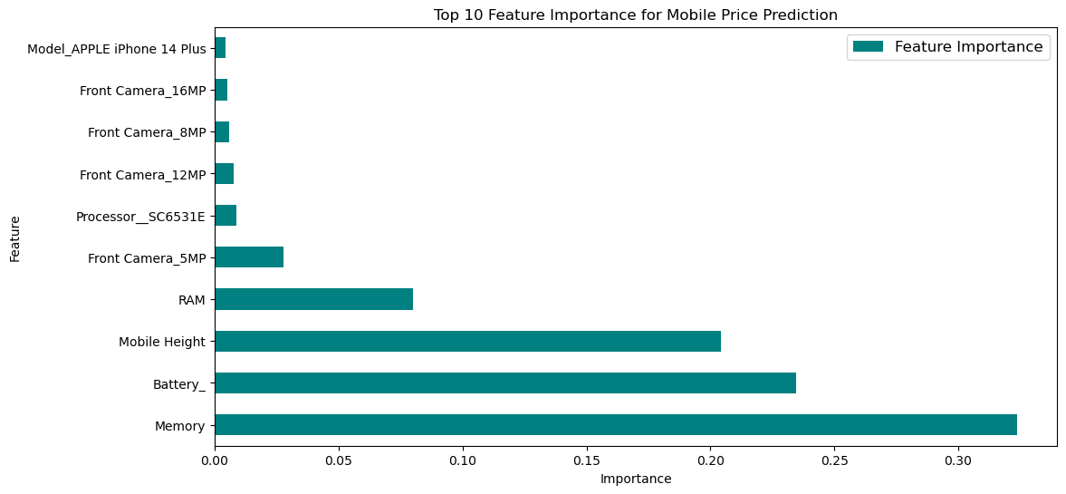

Slide 14
Conclusion and Key Takeaways
Effective Feature Extraction
It is crucial for enhancing the accuracy of price prediction models.
Model Evaluation Importance
Regular evaluation of models is necessary for maintaining prediction reliability
1
4
Data Quality Matters
High-quality data significantly impacts the overall performance of predictions.
Innovative Strategies
Adopting new techniques can improve forecast accuracy and model robustness.
2
5
Market Trends Awareness
Understanding current trends helps in making informed price predictions.
3
Actionable Insights
Providing clear steps helps the audience apply learning to their contexts
5

Slide 15
Thank you

